Slide 1





HR Employee Attrition Analytics Dashboard
An interactive data-driven analysis of workforce retention, job satisfaction, salary structures, and overtime trends.

Slide 2

Understanding Workforce Dynamics
Empowering HR professionals with actionable insights into attrition drivers, compensation equity, and employee engagement.

Slide 3

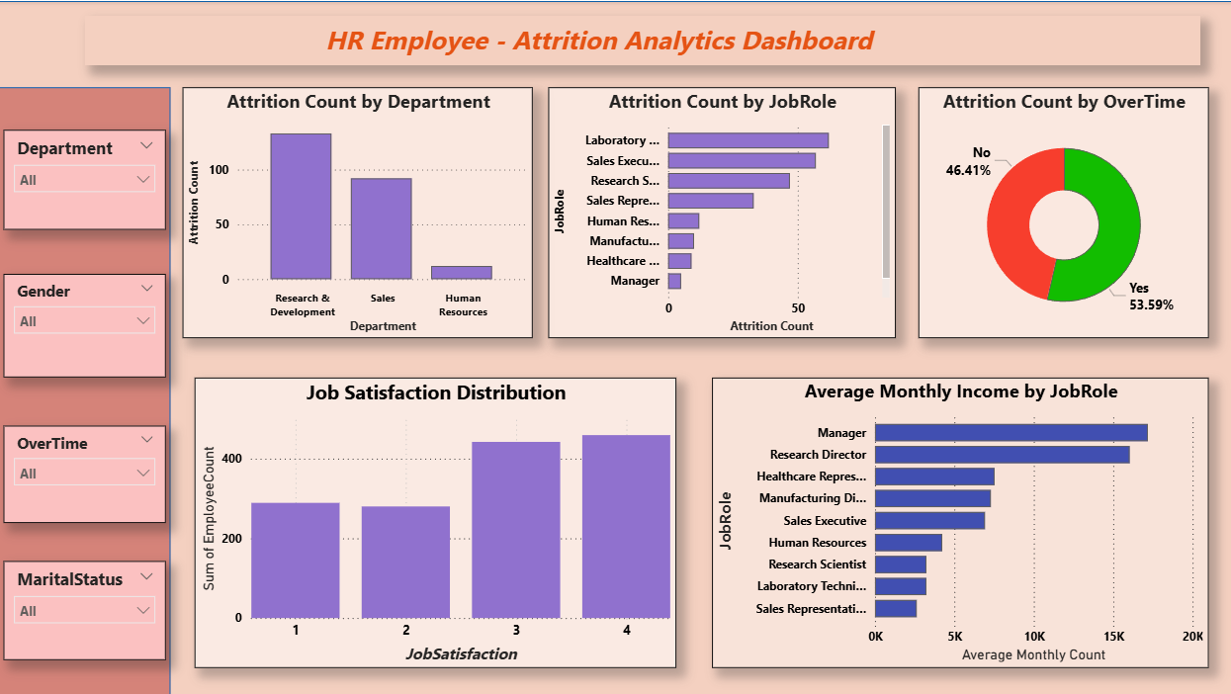
Project Overview
Interactive Dashboard
Built using Power BI Desktop, enabling real-time filtering across multi-dimensional employee attributes.
Slicer-Driven Discovery
Seamless drill-down by Department, Gender, Overtime status, and Marital Status for isolated analysis.
Strategic Retention
Identifies key operational bottlenecks contributing to employee turnover and lower job satisfaction.

Slide 4











Strategic Objectives
Department Attrition
Overtime Impact
Income Benchmarking
Analyze turnover rates across various operational departments and specific job roles to isolate high-risk groups.
Study the direct correlation between extended work hours and increased employee resignation rates.
Compare average monthly income structures across different job roles to evaluate pay equity and competitive positioning.
Satisfaction Analysis
Interactive Filtering
Data-Driven Action
Evaluate employee job satisfaction distribution to gauge overall workforce morale and engagement levels.
Deliver dynamic slicers for deep-dive analysis by demographic and organizational segments.
Provide executive leaders with clear baseline metrics to formulate proactive retention strategies.

Slide 5







Technology Stack
Power BI Desktop
Power Query
DAX Language
IBM HR Dataset
Core platform used for data modeling, visualization design, and executive dashboard layout.
ETL tool utilized for data cleansing, custom column transformations, and type definitions.
Engine used to compute complex KPIs, measures, aggregated metrics, and conditional ratios.
Rich underlying dataset containing comprehensive demographic, income, and performance metrics.

Slide 6






Core Workforce Metrics
TOTAL HEADCOUNT
ATTRITION COUNT
ATTRITION RATE
1,470
237
16.1%
Total workforce volume evaluated
Total employees who departed
Overall organizational turnover
AVERAGE AGE
AVG MONTHLY INCOME
AVG JOB SATISFACTION
36.9
$6,503
2.73 / 4
Years average employee age
Mean salary across all roles
Overall engagement score index

Slide 7
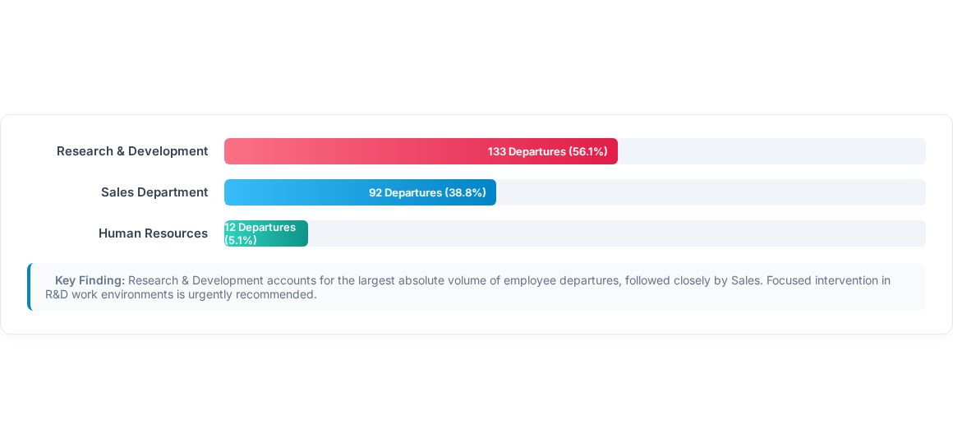
Department Attrition Analysis

Slide 8


Key Workforce Insights
Overtime Catalyst
Income Premium Roles
Engagement Driver
Employees regularly working overtime exhibit a significantly higher attrition rate compared to non-overtime staff.
Managers and Research Directors command the highest average monthly income, aligning with senior responsibility.
Job satisfaction rating serves as a pivotal metric directly influencing employee long-term retention.

Slide 9

Dashboard Architecture
Component Type | Metrics / Visual Elements | Strategic Value
KPI Cards | Headcount, Attrition Rate, Avg Age, Avg Salary, Satisfaction | Executive Summary
Breakdown Charts | Attrition by Dept, Job Role, Overtime & Satisfaction Distribution | Pattern Identification
Salary Analysis | Average Monthly Income grouped by Job Role | Compensation Review
Interactive Slicers | Department, Gender, Overtime, Marital Status | Ad-hoc Filtering

Slide 10


Empowering Data-Driven HR Decisions
The HR Analytics Dashboard turns raw employee data into strategic clarity. By highlighting attrition drivers, salary structures, and overtime burdens, HR leaders can take proactive measures to retain top talent and cultivate a healthier work environment.

